Slide 1
SQL Mini Project Submission– Mini Project Presentation
Authors
Jyothsna R
Madhuri S
Nirmal Prabhakar
Praveen Kumar Sharma

Slide 2
Dataset – Global Electronics Retailer
Data about various parameters of a global electronics retailer.
Tables include transactions, products, customers, stores, and currency exchange rates, for a period of 6 years in different countries, states, and cities.
Good for applying SQL concepts to extract information, analyse data and infer trends.
4. Salient Stats:
Tables : 5
Customers : 16k
Transactions : 63k

Slide 3

Our Goal
Create Schema and load retail data for analysis.
Perform Data cleaning
Perform descriptive and statistical data analysis.
Use Advanced SQL to extract data to perform non-obvious information and trends.
Notes:
Perform EDA
We explored the distribution of review scores, frequent keywords in review text, and correlations between review length, sentiment, and star ratings—revealing core patterns in user perception.
✅ Clean and Preprocess the Data
We handled missing values, parsed timestamp fields into datetime format, removed duplicates, and standardized text fields to ensure accurate and consistent analysis.
✅ Use Advanced Python Techniques to Extract Insights
We used lambda functions to classify reviews into sentiment categories, list comprehensions to identify apps with consistently low ratings, and custom functions to compute sentiment trends over time.

Slide 4
Summary of Analysis done
Customer Analysis.
Financial Analysis.
Sales Quantity and Volume.
Product Category Analysis.
Channel Analysis.
Geographic Analysis.
Time Based Analysis.

Slide 5
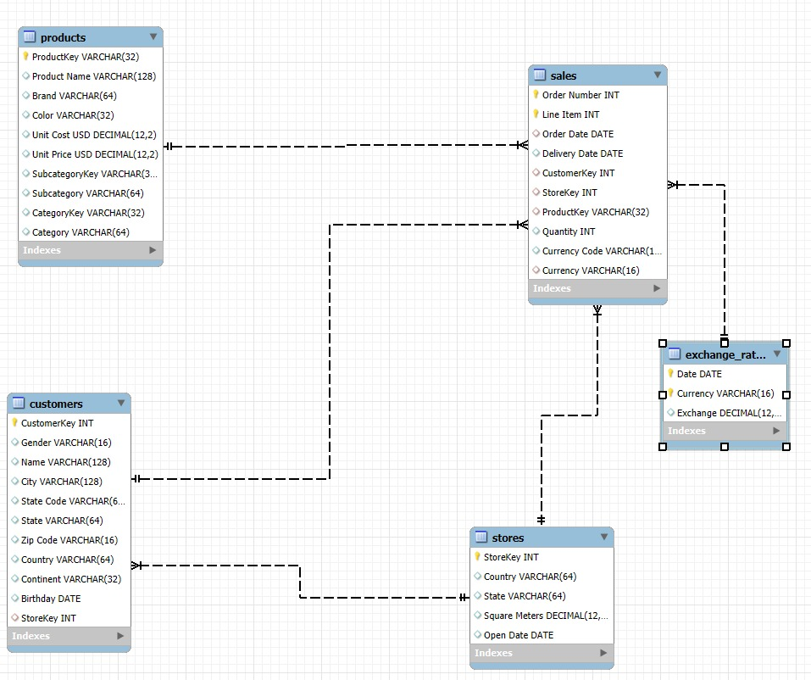
ER Diagram

Slide 6
Data Cleaning Summary
Check and Fill NULL Values
Format Dates
Duplicates Checks
Filling Missing Values

Slide 7
SQL Techniques Used
SQL Joins Subqueries CTE GroupBy Operations

Slide 8
Data Visualization
Monthly Sales Distribution
Sales per country

Slide 9
Data Visualization
Review Length Vs Rating
Top 10 products sold

Slide 10
Data Visualization
Online versus Offline sales
Top 10 products sold

Slide 11
Data Visualization
Total Sales Per Weekday

Slide 12
Key Findings
1. Revenue and Profit Distribution:
Total Revenue
Top-performing Countries
Revenue by Store Type
2. Customer and Product Insights:
Top Customers
Top Brands
3. Geographical and Temporal Analysis:
Revenue by Country
4. Operational Efficiency:
Delivery Duration

Slide 13
Thank You

